Slide 1
Computing Capstone Project
Using a Repository – Bitbucket
Version Control

Slide 2
Introduction
What is Git?
Intro: https://www.youtube.com/watch?v=w3jLJU7DT5E
GitHub vs Bitbucket
A useful walk-through can be found at Atlassian:
https://www.atlassian.com/git/tutorials/learn-git-with-bitbucket-cloud
Notes:
This talk is designed to cover concepts rather than details. There are too many different ways to interact with something like Bitbucket – command line, source tree, a IDE.

Slide 3
Repositories in Curtin Projects
The repository will be created and owned by the Department. Group members will have write access.
The purposes of using a repository:
Version control
Code backup
Managing multiple contributors
Team-based code checking
Keeping track of progress
Learning – you will most likely use repositories when working

Slide 4
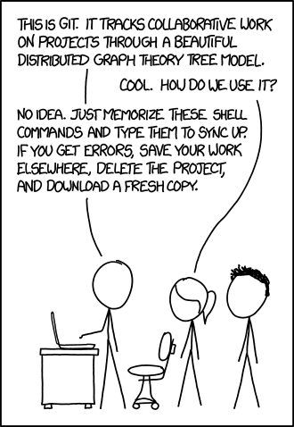
How to use Git?
From https://xkcd.com/1597/

Slide 5
Concepts
Clone – create a local working copy of the repository
Add – add files to the local copy
Commit – prepare local changes
Push – send committed changes to the repository server
Branch – a different version of the code (Master is the main one)
Merge – merge two branches into one
Pull – request for other team members to review new code
Notes:
You will need to look up these commands and find out how they work with the method that you’re using.

Slide 6
Non-Binary Files
Git is great for tracking text files.
It is not great for tracking binary files.
Use a .gitignore file to inform Git on what files (or types of files) shouldn’t be added to the repository.
As a rule, don’t commit executables or object files.
Notes:
Note – some errors have been reported when using a text editor to create a .gitignore file directly. Using the touch command is recommended.
An example of a decent gitignore file can be found at https://gist.github.com/octocat/9257657

Slide 7
Bitbucket DOs and DON’Ts
Do commit regularly. You are expected to commit at least once per week.
Always commit your own code. Never commit code written by someone else.
Name your commits sensibly (include task name/number).

Slide 8
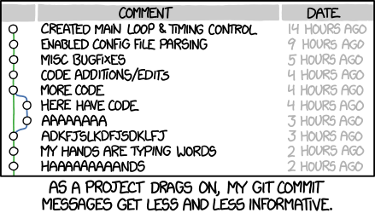
DON’Ts
From https://xkcd.com/1296/

Slide 9
Branches
What is the difference between Master and the other branches?
When do we create a branch?
When do we merge a branch?
There are several different strategies – agree on one.

Slide 10
Further Reading
Atlassian webinar on branching strategies: https://www.youtube.com/watch?v=9SZ7kSQ2424

Slide 11
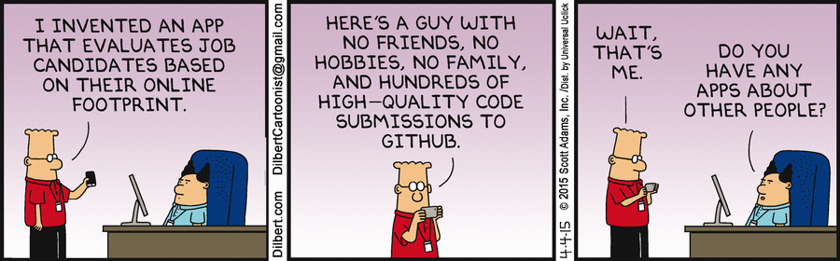
The End

